Slide 1

Proposal Presentation On Malicious-URL-Detection
Group 4:
Aishwarya Karki (c0903073)
Bikash Thapa Magar (c0907642)
Nirmala Regmi (c0903616)
Samar Fathima (c0908466)
Sijal Shrestha (c0910639)
Sujata Gurung (c0903143)

Slide 2
Preface for Problem Definition:
An estimated 12.8 million websites are infected by Malware.
The average click rate for a phishing campaign is 17.8%https://aag-it.com/the-latest-phishing-statistics/. Phishing campaigns that were more targeted and added phone calls had an average click rate of 53.2% – 3 times more effective.
Over 96% of malicious URLs—is with the use of URL link modifiers/shorteners.
Verizon reports that over 70% of all system intrusion breaches involve malware, and 32% of all malware is distributed via the web.

Slide 3
Possible Industry/Domain for M-URl-Detection Model
Cybersecurity
Financial Services
Technology and everyday Internet browsing
Protection of Sensitive data
E-Commerce

Slide 4
Problem & Target Consumer
Problem:
The project addresses the growing threat of malicious URLs on the internet.
Target Consumer:
Individuals using online platforms for various activities.
Businesses and organizations handling confidential data and customer information.

Slide 5
Problem & Target Consumer
Why the Target Consumer Should Care:
Phishing attacks result in identity theft, financial losses, and compromise of personal and corporate data.
Consequences include legal liabilities, loss of customer trust, and disruptions to operations.
Implementing an effective phishing detection system is crucial for protecting sensitive information and ensuring overall online security.

Slide 6
Differentiation
High-Quality Data:
Undergoes rigorous curation and quality control
Ensures accuracy, reliability, and consistency
Provides trustworthy data for impactful analysis
Extensive Feature Set:
Basic Components
Domain Information
Content Analysis
SSL certificate details
Real-World Relevance:
Includes both benign and malicious URLs for balanced analysis
Applicable to cybersecurity research and development projects

Slide 7
Differentiation
Probabilistic Machine Learning Algorithm:
Linear Support Vector Machine
Statistical Method
Logistic Regression
Generative Learning Algorithm:
Naive Bayes Algorithm
Validation and Benchmarking
Validates model performance and effectiveness

Slide 8
Data sources and Datasets:
The following Datasets are to be used for the project:
Malicious URL Dataset(Kaggle)
Phishtank URL Repository
DNSBlocklist Repository by Wu TingFeng

Slide 9
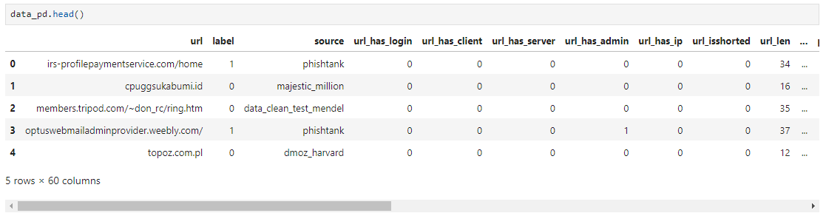
Dataset:

Slide 10
Distinguishing Features Against Competitors
Malicious URL Detection model built using Neural Networks and Logistic Regression models.
Model built on multiple different features designed around Content detection, SSL validity, Path and Query parameters, Network features, Machine Learning derived features and more.
Project built around scalability and continued development.
Model to be designed around minimum False Positive reduction.

Slide 11
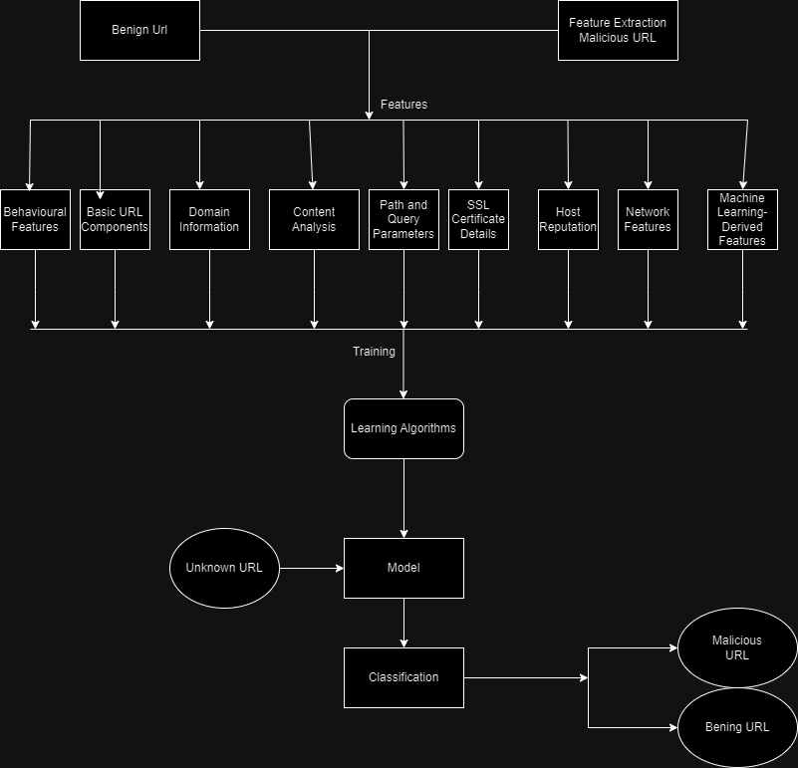
Wireframe:
Direct Link:

Slide 12

Any Questions?

